Slide 1
The Salvation Army’s Fight Against Human Trafficking
The Salvation Army
Manatee County Regional Coordinate
Major Marion Durham,
Associate Regional Coordinator

Slide 2
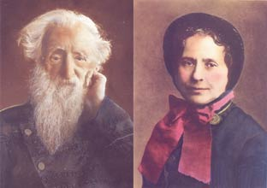
Salvation Army History
Founded in London, England in 1865 by
Methodist Minister Rev. William Booth and his wife, Catherine Booth
Fighting against human suffering of all kinds since our inception

Slide 3
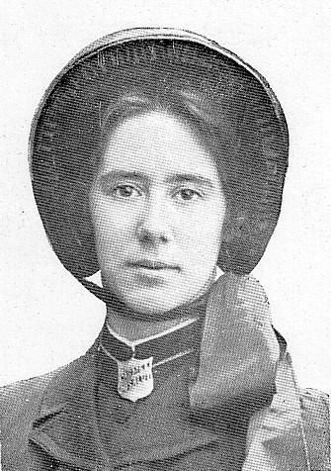
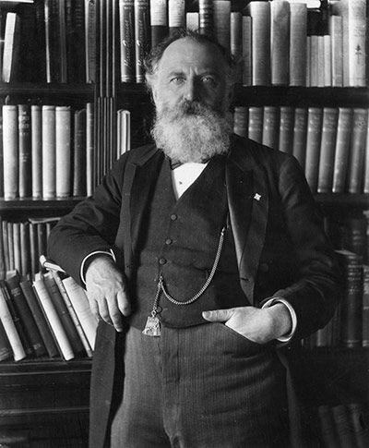
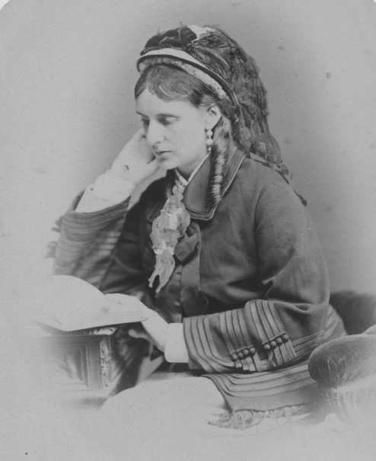
Salvation Army History
The Maiden Tribute of Modern Babylon
Fought and won the battle to prove a girl could be bought and sold as a slave
Helped raise the age of consent in England from 13 to 16

Slide 4
What is The Salvation Army Doing Today?
Working on a global scale
Project FIGHT (Raleigh, North Carolina)
Stop-It Program (Chicago)
The Haven Atlanta
2 Residential Programs (Cleveland and Tampa)
Numerous Outreaches

Slide 5
The Salvation Army in Florida
Ft. Walton Beach Strip Club Outreach
Panama City shelter and counseling (using established DV Safe House)
Tampa Area Command has a Human Trafficking Unit and Shelter
Numerous Trainings and Awareness programs

Slide 6
Tampa HT Program
Provide emergency shelter and stabilization services to trafficked women
Basic necessities
Entitlements
Medical Assistance
Legal Assistance
Mental Health Counseling
Case Management
Life Skills Classes and Empowerment Groups

Slide 7
The Salvation Army In Florida
Dotti Groover-Skipper is now on staff at The Salvation Army as the Divisional Coordinator of our Anti-Trafficking efforts
She is on Attorney General Pam Bondi’s Task Force to fight human trafficking in this state

Slide 8
Manatee, Sarasota and Desoto Counties
Major Marion Durham is part of a leadership team that is establishing a coalition against human trafficking for this region
Team includes The Salvation Army, More Too Life, Selah Freedom and the Sarasota Commission on the Status of Women

Slide 9
Manatee, Sarasota and Desoto Counties
Currently meeting our goals of expanding the coalition to include law enforcement, local agencies and legal services for survivors
Held training workshops (Trafficking 101)
Law Enforcement Luncheon
Joined the umbrella of The FREE Network, Slavery Survival Network

Slide 10
Manatee, Sarasota and Desoto Counties
Continuing to expand and grow membership
Email coalition list of over 100 caseworkers, law enforcement, etc.
Establishing a Resource Directory for our region’s use in assisting survivors
Future goals include
formation of committees
expanding leadership beyond four main leaders

Slide 11
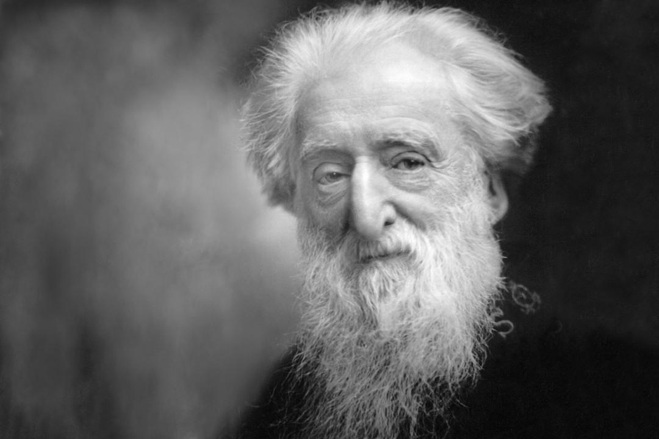
“While women weep,
as they do now,
I'll fight!
While little children go hungry, as they do now,
I'll fight!
While men go to prison, in and out, in and out, as they do now,
I'll fight!
While there is a drunkard left,
While there is a poor lost girl upon the streets,
While there remains one dark soul without the light of God,
I'll fight-I'll fight to the very end!”
― General William Booth

Slide 12
The Salvation Army of Manatee County
Contact Information:
Marion_Durham@uss.salvationarmy.org
Partners needed for an upcoming strip club outreach project

